Slide 1
Testing Components

Slide 2
Testing
Manual
The tester takes over the role of an end-user and tests the software to identify any unexpected behavior or bug
Automation
The tester writes scripts and uses another software to test the product. This process involves automation of a manual process.

Slide 3
Testing levels
Unit
Unit testing refers to tests that verify the functionality of a specific section of code, usually at the function level.
Integration
Integration testing works to expose defects in the interfaces and interaction between integrated components (modules).
System (alpha, beta)
System testing tests a completely integrated system to verify that the system meets its requirements.

Slide 4
Tools we will use
Unit testing
Jasmine – testing framework
Karma – test runner
PhantomJS, Chrome (headless)
Integration testing (not this time)
Protractor – test runner, allows us to handle browser behavior

Slide 5
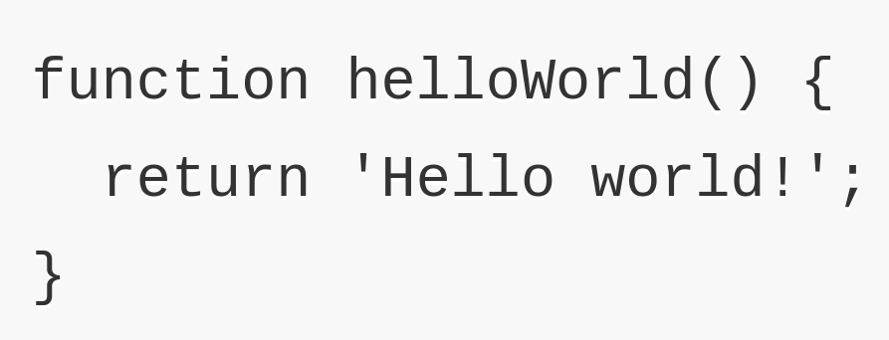
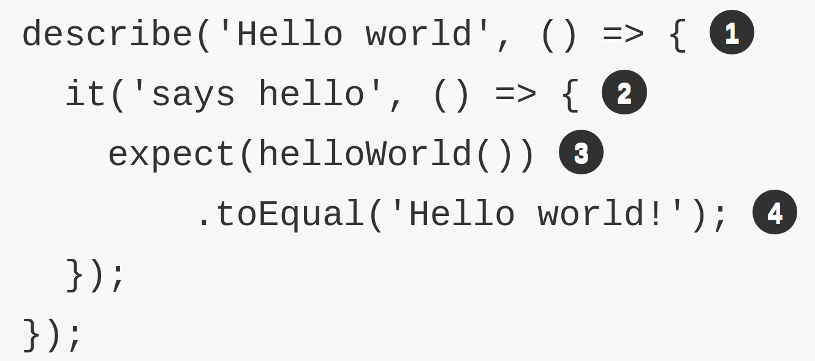
Jasmine test example

Slide 6
Setup and teardown
beforeAll
afterAll
beforeEach
afterEach

Slide 7
Matchers
toBeDefiened()
toBeFalsy()
toEqual()
toThrow()
and more...
Custom matchers

Slide 8
Q&A

Slide 9


